Slide 1
Maintaining Architectural Integrity With Automated Dependency Monitoring in CI
Karthick Shanmuga Rao

Slide 2
Agenda
Problem Statement, based on real project experiences
Solution Approach
The Development Workflow with CI Pipeline Checks Implemented
Demonstration
Example Code base for Demo
Setting up files in repo for dependency monitoring
Triggering the Checks
Tools available in the sw-deps-monitor repo
List of tools used in the CI Pipeline
Additional tools like dependency visualization
Introduction to Software Coupling Metrics for analysing maintainability
Utility to generate a coupling metrics report
Summary

Slide 3
Problem Statement
In large scale projects, the architects and technical leads define software architecture with number of software components / layers for different purposes, then multiple developers contribute to the development.
During the development with large team, there are high possibilities of creating unwanted dependencies between the libraries that violate the separation of concerns defined by the Architecture definition.
Overtime, these unwanted dependencies get accumulated leading to a situation where every library call each other resulting in an unstructured, tangled codebase (also known as "Big Ball of Mud" architecture anti-pattern)

Slide 4
Without Dependency Monitoring
With Automated Dependency Monitoring
A
A
B
C
B
C
D
E
F
D
E
F
❌ Developers may introduce dependencies violating architecture defined.
❌ Dependency issues affects code reusability. (When you want to reuse a library in another project, you might have to copy all the dependencies)
❌ Not possible to make modular binaries and modular deployment (Circular dependencies hinder modular packed project library builds)
❌ Modules cannot be isolated and tested.
❌ LabVIEW project files load slower since many unnecessary dependencies may load into memory when you want to edit a specific project. (Example: When you open Project B, all the libraries are loaded into memory)
✅ Developers cannot introduce wrong code dependencies, they adhere to defined Design and expected dependencies (defined by Leads)
✅ Modules remain modular and reusable over time. (When you want to reuse a library in another project, you copy only required code)
✅ Modules are clearly separated and modular builds, modular deployment are possible.
✅ Modules can be isolated and tested. Improves Testability and Debuggability.
✅ Modules load faster into memory during the development.
(Example: When you open project B for editing, only required libraries B and D are loaded into memory)

Slide 5
Solution Approach
Define Expected Dependencies for each Library in the repository.
Create and maintain a Project file (lvproj) per library – To programmatically read the actual dependencies of libraries.
In the CI Pipeline
Programmatically compare the expected dependencies with actual dependencies for each library that get modified in each PR.
Programmatically create a file with all actual dependency mappings, construct a Directional graph and perform circular dependency check.

Slide 6
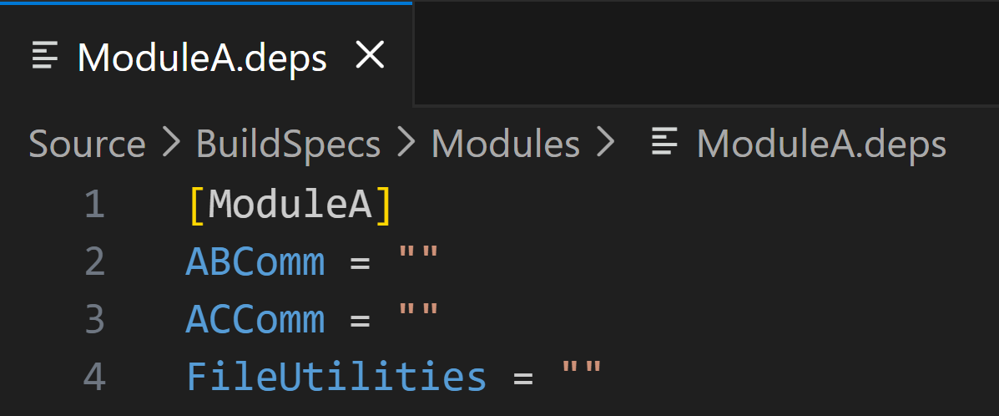
Expected Dependencies File (.deps)
For every library create a “.deps” file
Section name → Library Name
Key Names → Dependant Library Names.
Example:
ModuleA.deps (for the ModuleA.lvlib)

Slide 7
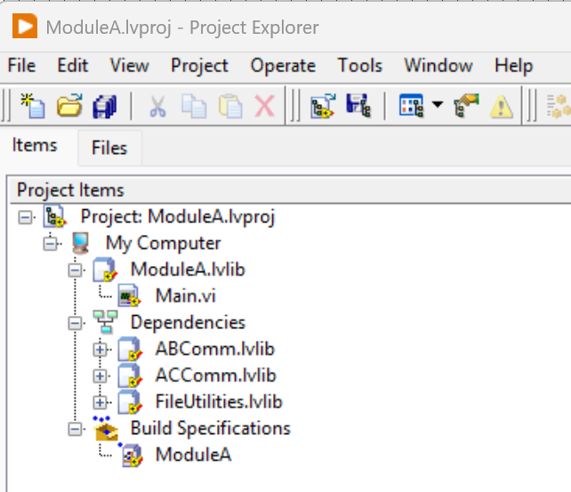
Actual Dependencies (.lvproj)
1. For Every library “.lvlib” create a project “.lvproj” file.
2. This project files can be read by automation to read the actual dependencies of a lvlib.
3. This project can also include the build specification for the library.
Example:
ModuleA.lvproj (for the ModuleA.lvlib)

Slide 8
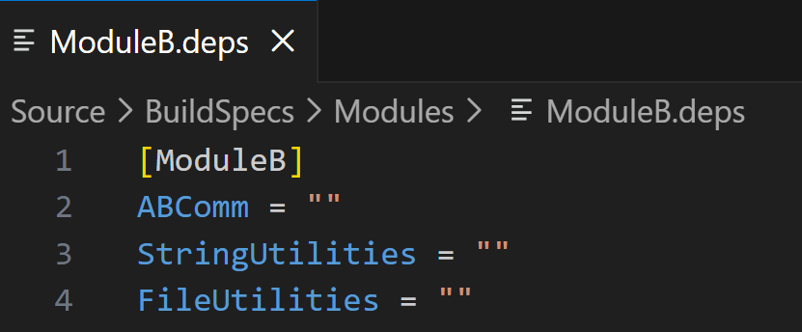
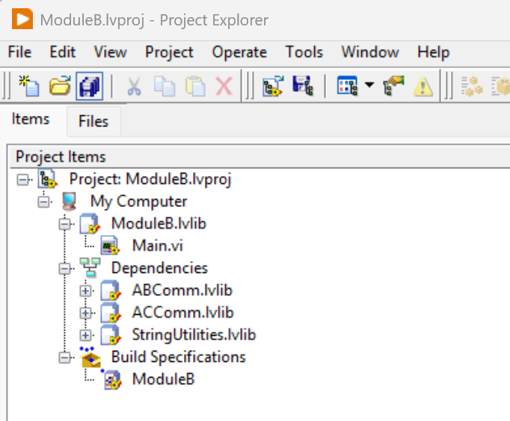
Dependency Check – Examples
Example 1: ModuleA.lvproj (Actual dependencies) match with the ModuleA.deps (Expected dependencies)
✅ Pass – No Unexpected Dependencies
Example 2: ModuleB.lvproj (Actual dependencies) does not match the ModuleB.deps (Expected dependencies)
❌ 1 Unexpected Dependency Found
ACComm.lvlib
❌ 1 Expected Dependency Missing
FileUtilities.lvlib

Slide 9
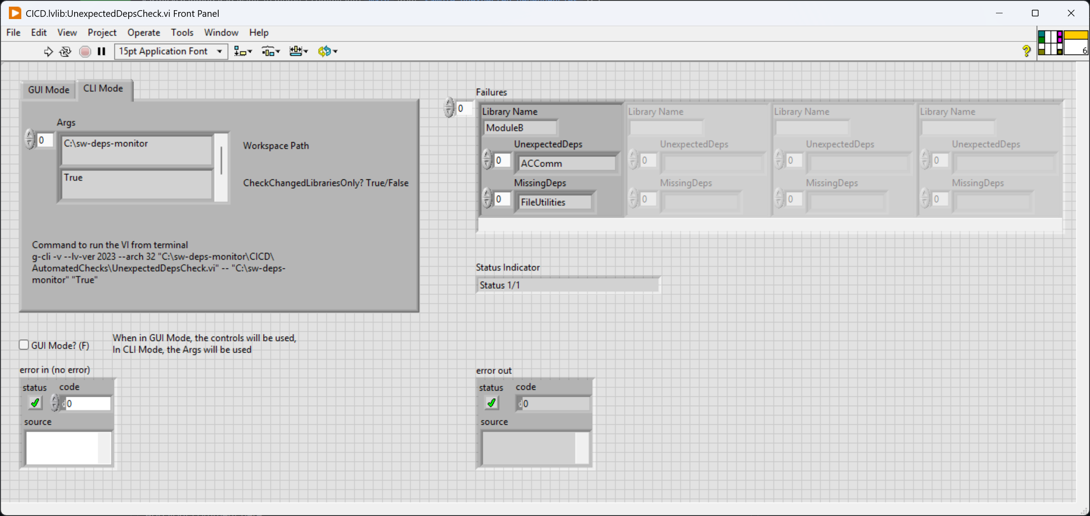
Automate Unexpected Dependencies Check
UnexpectedDepsCheck.vi – VI used to perform unexpected Dependencies Check
Can be run in GUI Mode or CLI Mode.
Has option to limit the check only to Changed Libraries in a PR.
Library wise failures are displayed.

Slide 10
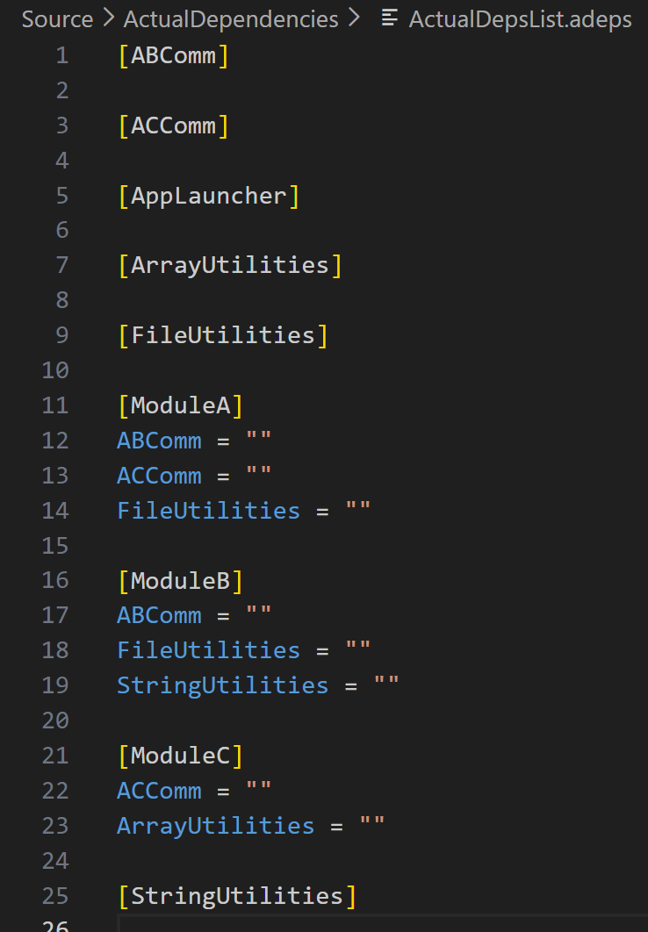
Consolidated Actual Dependencies List (.adeps)
This File is generated by automation with all the dependency mappings obtained from all the lvproj files.
Represents all the actual dependency links in the repository.
Automation uses this to construct a Directional Graph Data structure and finding the circular dependencies that hinder Modular PPL builds.
Circular Dependency Example: If developer calls a typedef from ModuleA.lvlib in ABComm.lvlib.
A Key “Module A” is inserted into “[ABComm]” It will form a circular path: ModuleA → ABComm → ModuleA

Slide 11
Development Workflow
Initial Setup: Create .lvproj for each .lvlib to track actual dependencies.
Initial Setup: Tech Leads Define the Expected Dependencies (.deps) for each .lvlib in the repository.
For each feature development, a PR is created in the repository for review
CI Checks run in a Virtual Machine
If CI Checks Fail or Pending, PR merge is blocked
Scenario 1: Developers understand the failures and defined boundaries, update the code accordingly to adhere to the defined dependencies.
Scenario 2: Developers propose change in .deps and get approval. This is a Guided change in design.
After the fix, the checks are trigged again, and the checks pass.
If CI Checks Pass, PR merge is allowed

Slide 12
Example Codebase for Demonstration
Overview
✅ The Main.vi in Module A and Module B are asynchronously running modules
✅ Module A can communicate to the Module B using the Communication library (ABComm.lvlib)
Separation of Concerns
✅ Modules A and B should not directly depend on each other so that each can be independently used in a different project.
✅ Communication Libraries should not implement any functionalities using the low-level utilities.
Note:
The Main.vi of modules can be run independently or a separate AppLauncher.lvlib:Launcher.vi can be used to launch them.
Developer Scenarios:
Developer uses a typdef from ModuleB.lvlib in the ModuleA.lvlib
Check fails, unexpected dependency. Developer fixes this in code.
Developer uses StringUtilities in ModuleA.lvlib
Check fails, this time Developer proposes change in ModuleA.deps since there is a need and it does not affect the reusability of Module.
ABComm.lvlib
ModuleA.lvlib
Scenario 1
ModuleB.lvlib
Scenario 2
FileUtilities.lvlib
StringUtilities.lvlib

Slide 13
Example Codebase – Folder Structure
sw-deps-monitor/
├── .github/workflows/ # Folder with github workflows
├── CICD/ # Automated Check VIs for CICD
├── Source/ # Source Code
│ ├── Modules/ # Independent Modules
│ │ ├── ModuleA/
│ │ │ ├── ModuleA.lvlib
│ │ │ ├── <Files associated>
│ │ ├── ModuleB/
│ │ │ ├── ModuleB.lvlib
│ │ │ ├── <Files associated>
│ ├── Communication/ # Communication Modules to carry message between async modules
│ │ ├── ABComm/ # Communication Module for Module A and B
│ │ │ ├── ABComm.lvlib
│ │ │ ├── <Files associated>
│ ├── Utilities/ # Low level utilities for String, File and Array operations
│ │ ├── StringUtilities/
│ │ │ ├── StringUtilities.lvlib
│ │ │ ├── <Files associated>
│ │ ├── FileUtilities/
│ │ │ ├── FileUtilities.lvlib
│ │ │ ├── <Files associated>

Slide 14
Demonstration
Setting up dependency monitoring files - expected dependencies (.deps) file and project files for each library.
List of tools used in CI Pipeline and CI Pipeline YAML walkthrough.
Manually running the dependencies check without CI Pipeline.
Triggering the CI Pipeline for each Pull Request.
Everyday Scheduled Automated Check on whole repository.
Consolidated Actual Dependencies List Creation
For easy overall review of dependencies in a repo,
For performing the circular dependencies check.
Reference Links
Repository with the Dependency monitoring setup
https://github.com/karthickshanmugarao/sw-deps-monitor

Slide 15
Initial Setup
Prerequisites
LabVIEW 2023 Q3 or higher
Install the VIPM package dependencies by applying the VIPC available in the repository
sw-deps-monitor\CICD/VIPC
uv for python
Setting up the dependency monitoring files
Create .lvproj for each .lvlib
Create .deps file with expected dependencies defined for each .lvlib
Helper Tools available at
sw-deps-monitor/CICD/DevTools
Setup Self Hosted Runner in a VM
Steps are described in GitHub when creating a self-hosted runner using the option, Repository Settings → Actions → Runners → New self-hosted runner

Slide 16
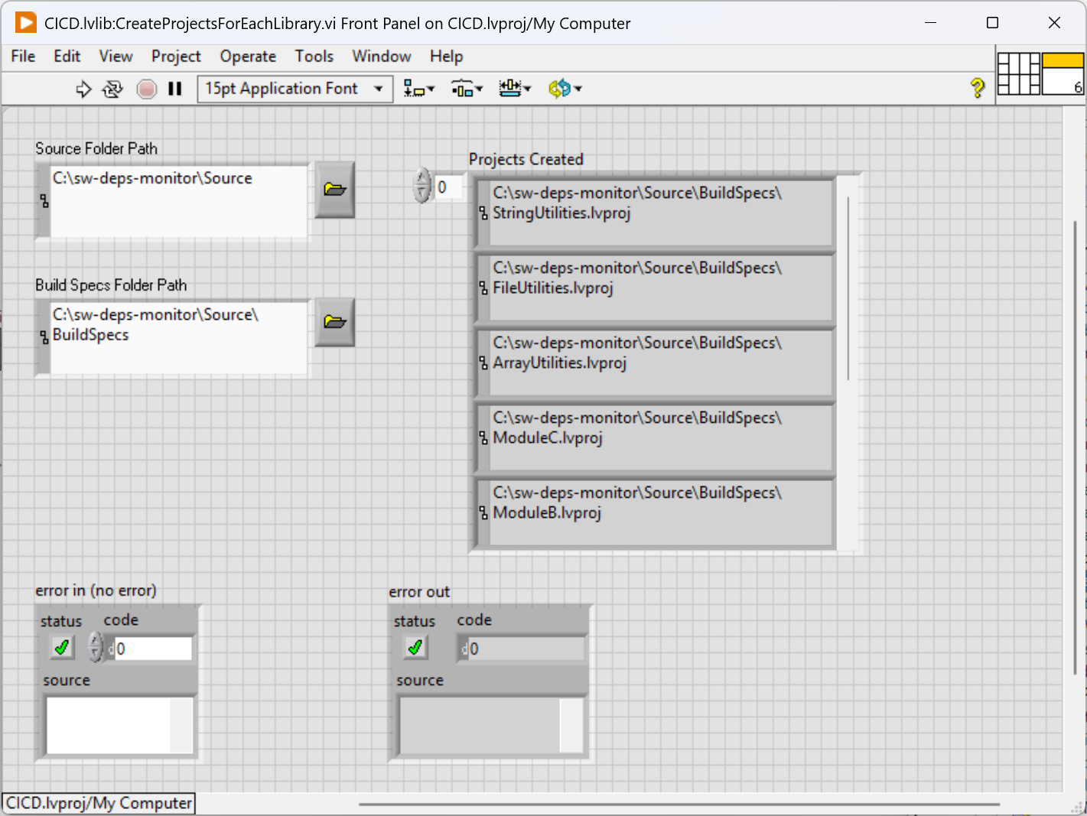
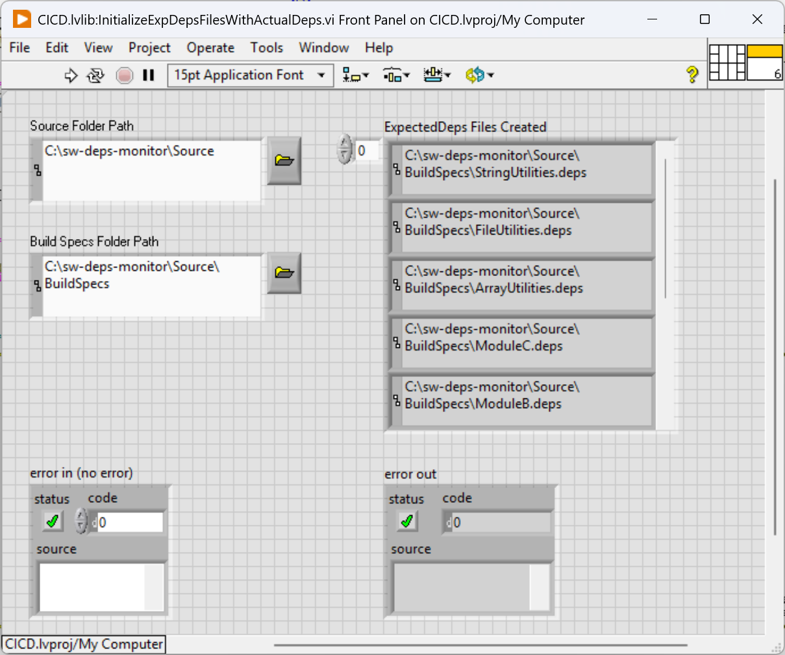
Setting up Dependency Monitoring Files
CreateProjectsForEachLibrary.vi
VI to create separate lvproj for each .lvlib found in repository ‘Source’ folder.
This creates the lvproj files in the folder selected ‘BuildSpecs’.
Manually can be rearranged with nested folders as needed for easy navigation.
InitializeExpDepsFilesWithActualDeps.vi
VI to create expected dependency files (.deps) for each. lvlib found in repository ‘Source’ folder.
The expected dependency files are created with actual dependencies found in the .lvproj files.
The .deps need to be reviewed and updated by the Leaders to define the expected dependencies.

Slide 17
Setting up Dependency Monitoring Files
sw-deps-monitor/
├── Source/
│ ├── ActualDependencies/
│ │ ├── ActualDepsList.adeps # This File has consolidated Actual Dependencies Mapping in repo
│ ├── BuildSpecs/ # Folder with .lvproj files and .deps files for dependency monitoring.
│ │ ├── Modules/
│ │ │ ├── ModuleA.lvproj Note: The folder name is BuildSpecs since the same lvproj files which
│ │ │ ├── ModuleA.deps are used to read actual dependencies can also be used to
│ │ │ ├── ModuleB.lvproj maintain the build specifications for libraries.
│ │ │ ├── ModuleB.lvproj
│ │ │ ├── ModuleB.deps
│ │ ├── Communication/
│ │ │ ├── ABComm.lvproj
│ │ │ ├── ABComm.deps
│ │ ├── Utilities/
│ │ │ ├── StringUtilities.lvproj
│ │ │ ├── StringUtilities.deps
│ │ │ ├── FileUtilities.lvproj
│ │ │ ├── FileUtilities.deps

Slide 18
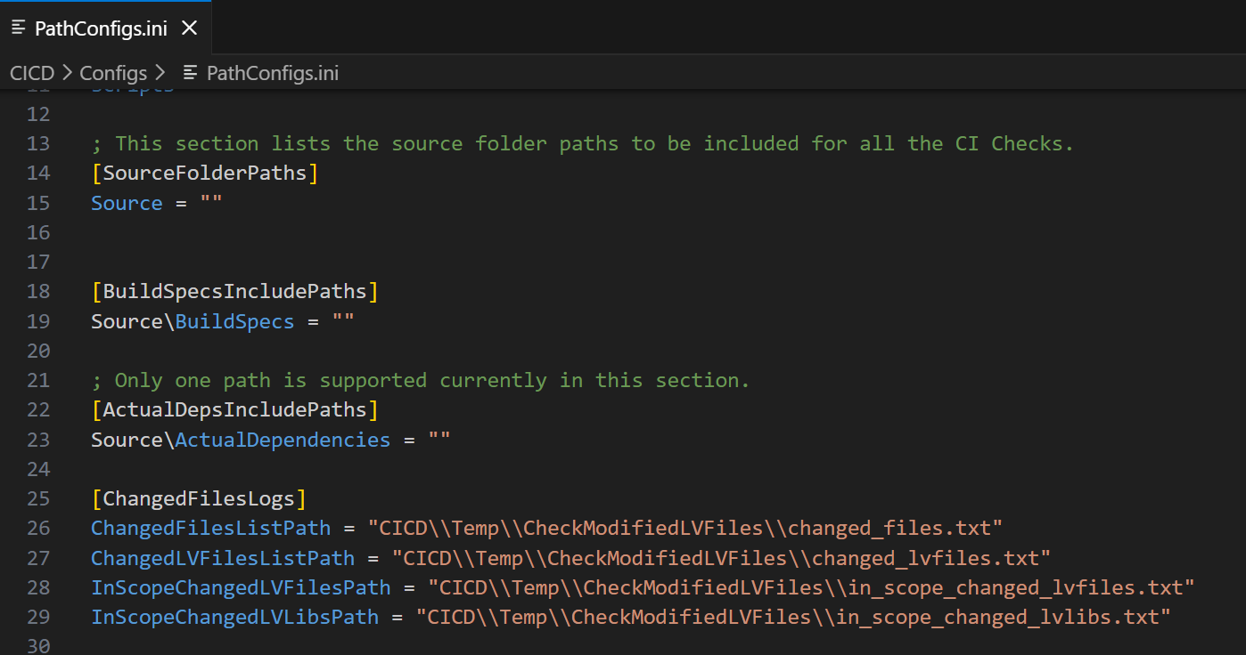
Setting up Dependency Monitoring Files
Default Path Configurations – Need not be changed if same folder names are used
The automation VIs and python scripts use these configurations.
SourceFolderPaths – Relative Paths to the folders which contain the source code. Automation checks for the lvlib files in these folders for Dependency Checks.
BuildSpecsIncludePaths – Source\BuildSpecs – This is the folder where we have the .lvproj files and .deps files
ActualDepsIncludePaths – This folder contains the consolidated ActualDepsList.adeps file.
ChangedFilesLogs – These are internally used by python scripts and few automation Vis to list the changed_files in a PR.

Slide 19

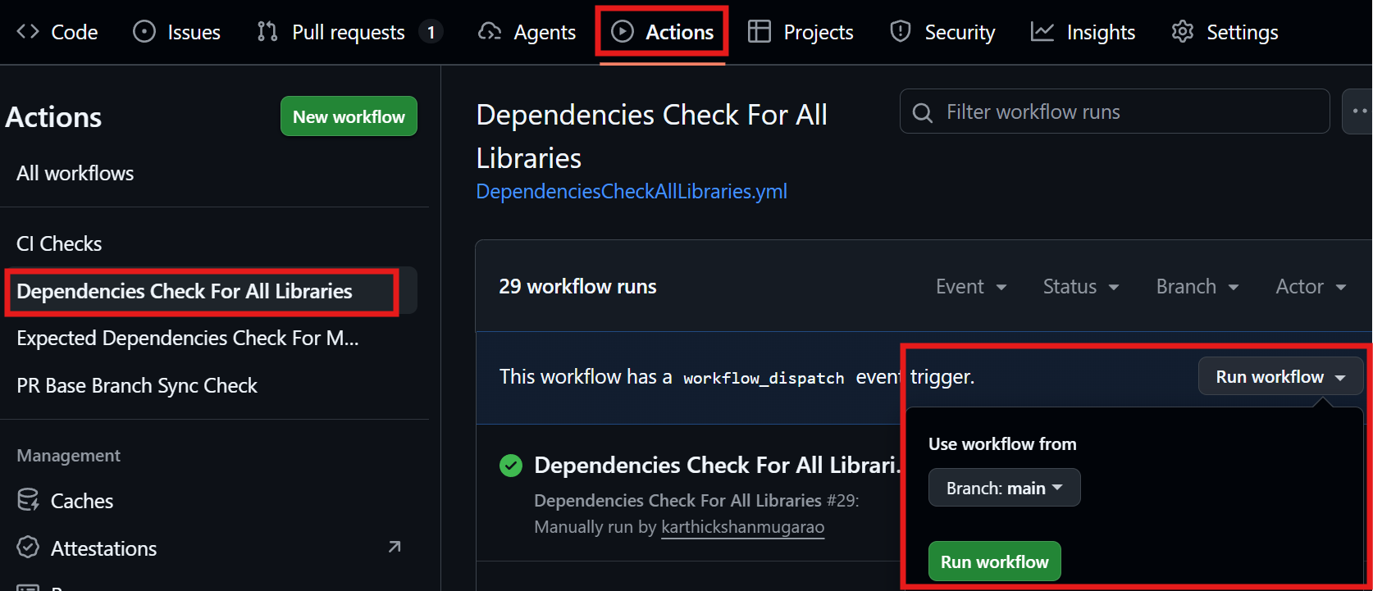
Demonstration
Manually running dependency check without CI Pipeline.
g-cli -v --lv-ver 2023 --arch 32 "C:\sw-deps-monitor\CICD\AutomatedChecks\UnexpectedDepsCheck.vi" -- "C:\sw-deps-monitor" "False"
Triggering the CI Pipeline for each PR. This checks only the libraries modified in a PR.
Add a label ‘RunCI’ in the PR to trigger the CI Pipeline.
This helps avoid unnecessary runs on every commit or push.
Triggering the CI Pipeline for all the libraries in repository. This is also configured to run everyday.

Slide 20
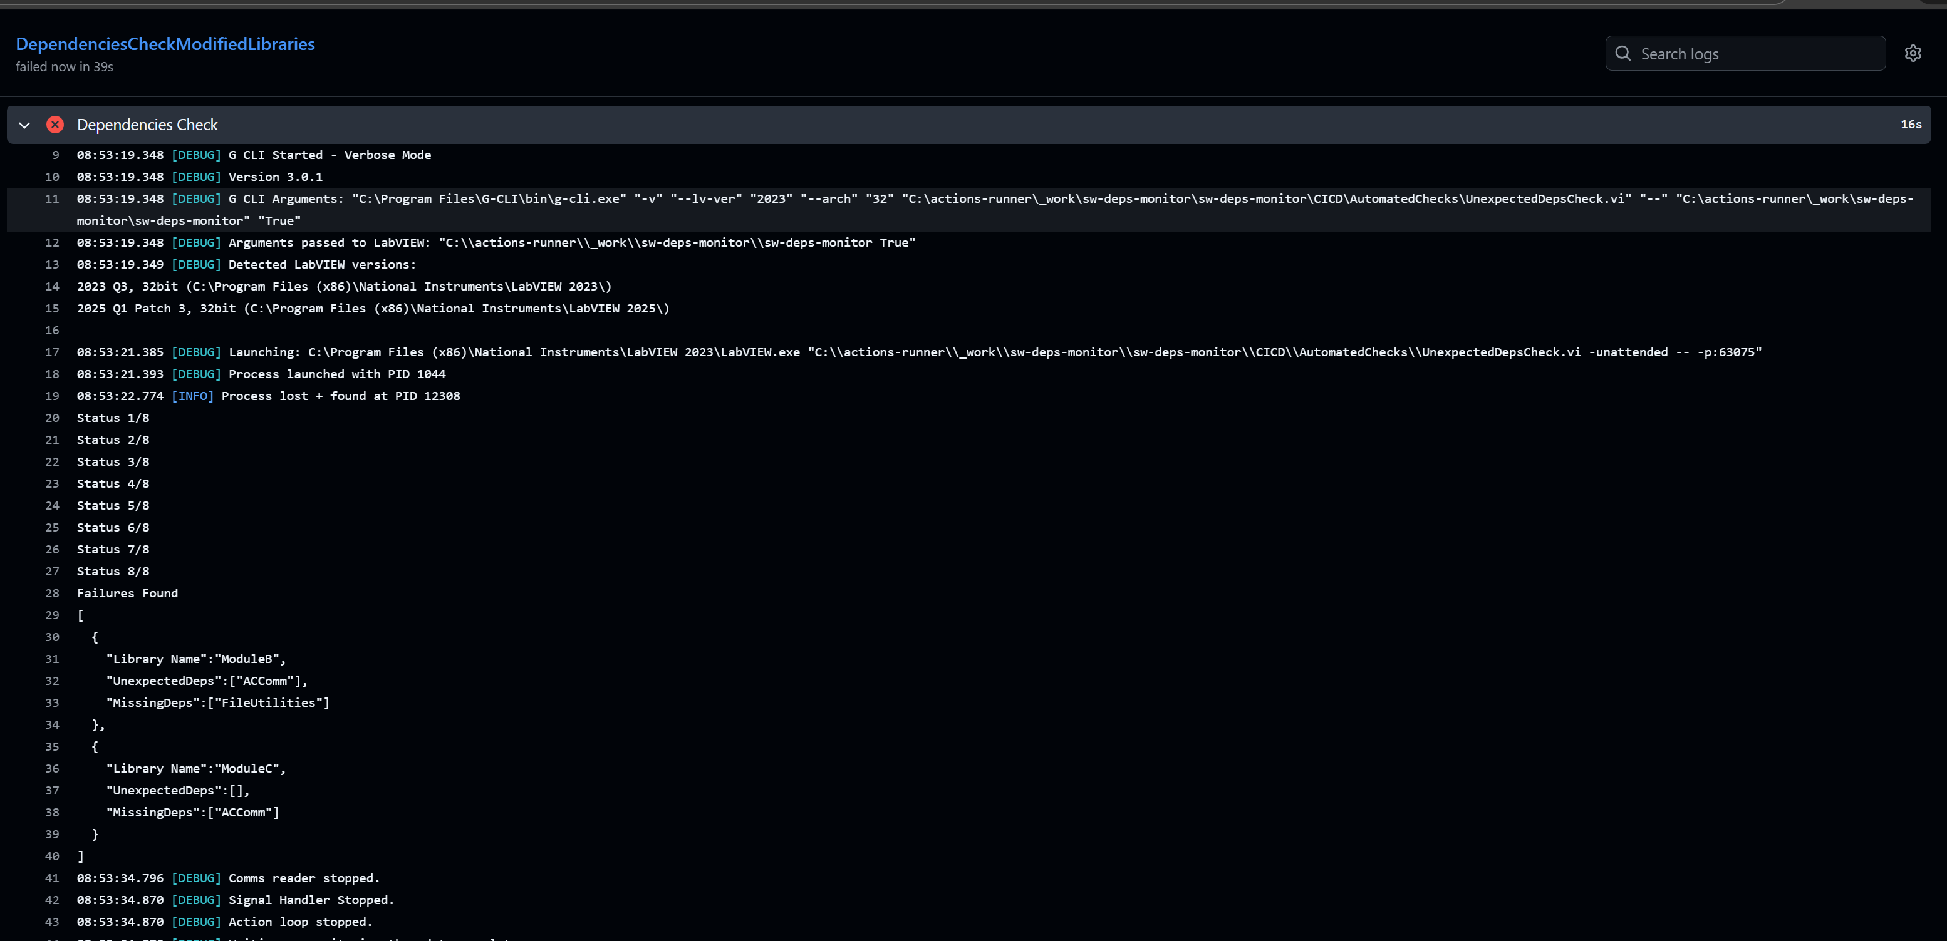
Demonstration – Sample Failure in CI Pipeline

Slide 21
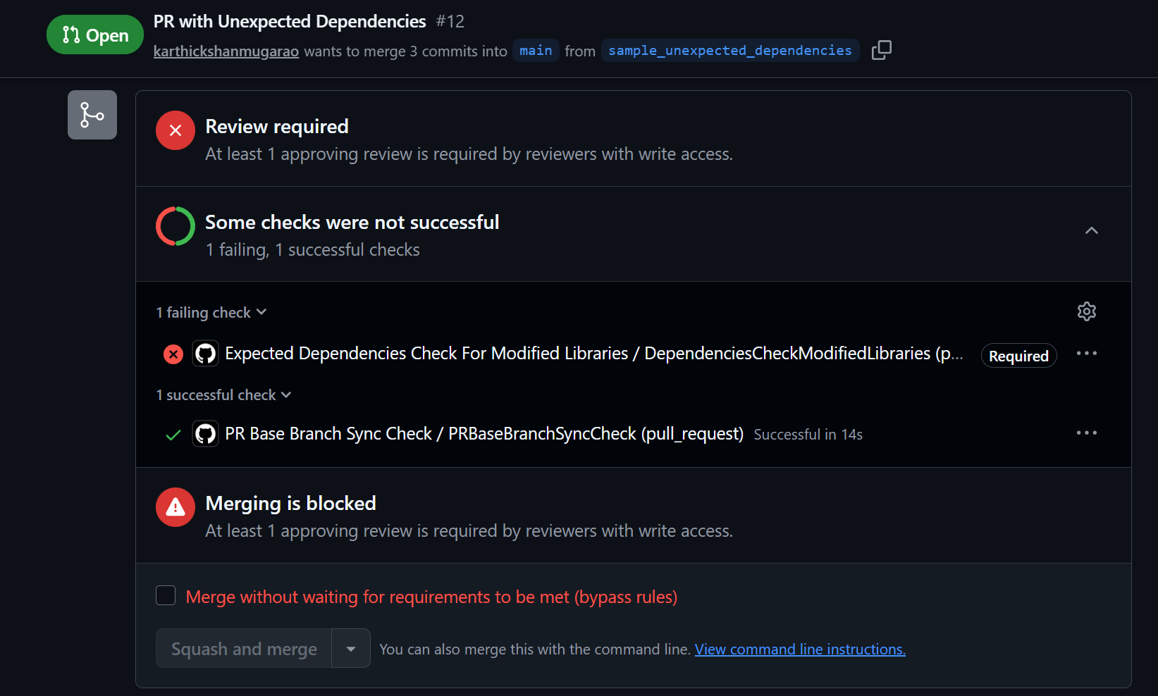
Demonstration – Merge Blocked by CI Pipeline

Slide 22
List of Available YMLs
S. No. | Name | Description
1. | DependenciesCheckModifiedLibraries.yml | Implements Automated Dependency Checks on libraries that are modified in the current PR.
2. | DependenciesCheckAllLibraries.yml | Implements a scheduled Automated Dependency check on all the libraries in the repository. Regenerates the Consolidated Actual Dependencies List (adeps) file and creates a PR automatically if there are new changes observed in the adeps file. This helps report any changes that were not covered in any PRs. Example: If a library is modified, only its section is updated in the previous yml, other affected changes can also be observed here.
3. | PRBaseBranchSyncCheck.yml | Checks if the base branch is in sync with the head branch in the PR.

Slide 23
List of Available Tools
S. No. | Name | Description
1. | generate_changed_files_list.py | This python script finds the list of changed files and libraries in the current branch and saves the details in the files under the folder 'CICD/Temp/CheckModifiedLVFiles/’. Useful to filter and perform automated checks only on the libraries that are edited in current PR.
2. | UnexpectedDepsCheck.vi | Compares the expected dependencies (defined in .deps files) with the actual dependencies (programmatically read from the lvproj files), returns the failures. ‘CheckChangedLibrariesOnly` is available to check only the libraries that are edited in the current branch. ‘generate_changed_files_list.py’ is pre-requisite.
3. | UpdateActualDepsList.vi | Updates the ActualDepsList.adeps file with the current actual dependencies read from the lvproj files
4. | find_circular_paths.py | Finds circular dependency paths in the ActualDepsList.adeps file and reports them in the console output
5. | generate_full_dependency_graph.py | Generates a full dependency graph image from the ActualDepsList.adeps file to represent the dependencies observed between all the libraries

Slide 24
List of Available Tools
S. No. | Name | Description
6. | generate_dependency_graph_for_selected_nodes.py | Generates a dependency graph image output for each selected node/library passed as argument to the script
7. | find_root_nodes.py | Finds the root nodes/libraries in the ActualDepsList.adeps file and reports them in the console output. This is useful when performing complete rebuild of the project. If we rebulid all the root nodes along with their descendants in the graph, then all the modules will be rebuilt
8. | sort_actual_deps_list.py | Sorts the ActualDepsList.adeps file in alphabetical order to make it easier to read and compare with the previous versions of the file in pull request reviews.
Notes:
1. scripts/generate_changed_files_list.py
- This python script finds the list of changed files and libraries in the current branch and saves the details in the files under the folder 'CICD/Temp/CheckModifiedLVFiles/'. This is useful for pull request reviews to perform automated checks only on the libraries that are edited in the current branch.
2. CICD/AutomatedChecks/UnexpectedDepsCheck.vi
- This VI compares the expected dependencies (defined in .deps files) with the actual dependencies (programmatically read from the lvproj files) and reports any unexpected dependencies.
- Option `CheckChangedLibrariesOnly` is available to check only the libraries that are edited in the current branch, which is useful for pull request reviews. To use this option, the script 'scripts/generate_changed_files_list.py' need to be run before running this check.
3. CICD/AutomatedChecks/UpdateActualDepsList.vi
- This VI updates the ActualDepsList.adeps file with the current actual dependencies read from the lvproj files.
- Option `UpdateForChangedLibrariesOnly` is available to update the sections of the ActualDepsList.adeps that correspond to the libraries that are edited in the current branch, which is useful for pull request reviews. To use this option, the script 'scripts/generate_changed_files_list.py' need to be run before running this VI.
4. scripts/find_circular_paths.py
- This script finds circular dependency paths in the ActualDepsList.adeps file and reports them in the console output.
5. scripts/generate_full_dependency_graph.py
- This script generates a full dependency graph image from the ActualDepsList.adeps file to represent the dependencies observed between all the libraries in the repository. The generated image will be saved in the 'reports' folder.
6. scripts/generate_dependency_graph_for_selected_nodes.py
- This script generates a dependency graph image output for each selected node/library passed as argument to the script. Example: `python generate_dependency_graph_for_selected_nodes.py --nodes ModuleA ModuleB`. The generated images will be saved in the 'reports' folder.
7. scripts/find_root_nodes.py
- This script finds the root nodes/libraries in the ActualDepsList.adeps file and reports them in the console output. Root nodes are the libraries that do not have any other libraries depending on them.
- This is useful to find the top level libraries in the project. This is useful when performing complete rebuild of the project. If we rebulid all the root nodes along with their descendants in the graph, then all the modules will be rebuilt.
- This is useful when we want to make sure that all the modules are rebuilt after a change that affects multiple modules.
8. scripts/sort_actual_deps_list.py
- This script sorts the ActualDepsList.adeps file in alphabetical order to make it easier to read and compare with the previous versions of the file in pull request reviews.

Slide 25
Example Codebase for Visualization
Overview: Similar to previous example with few additional libraries
✅ Modules A, B and C are asynchronously running modules
✅ Module A can communicate to the Module B and Module C using the Communication libraries (ABComm.lvlib and ACComm.lvlib).
Separation of Concerns
✅ Modules A, B and C should not be dependent on each other.
✅ Communication Libraries should not implement any functionalities using the low level utilities.
Note:
Main.vi of Modules A,B, C can be run independently or a separate AppLauncher.lvlib:Launcher.vi can be used to launch them.
ABComm.lvlib
ACComm.lvlib
ModuleB.lvlib
ModuleA.lvlib
ModuleC.lvlib
StringUtilities.lvlib
FileUtilities.lvlib
ArrayUtilities.lvlib

Slide 26
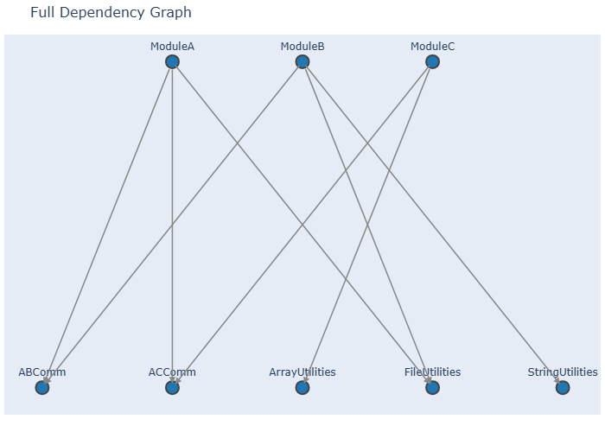
Dependency Visualization Tools
generate_full_dependency_graph.py
Script to generate a visualization for all the libraries and its dependencies.
Uses the details available in the ActualDepsList.adeps

Slide 27
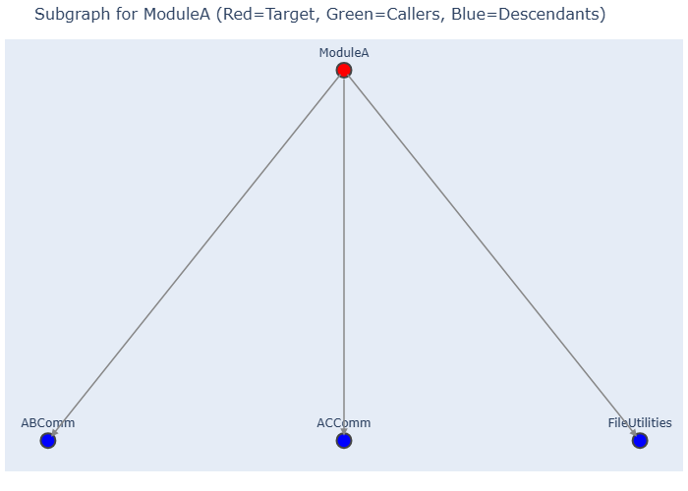
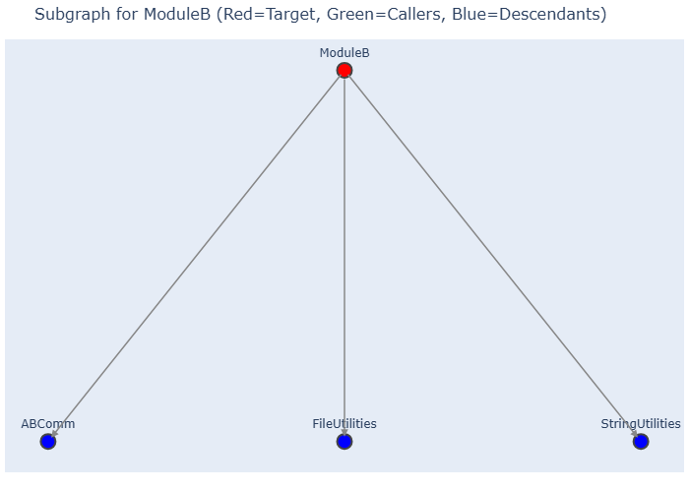
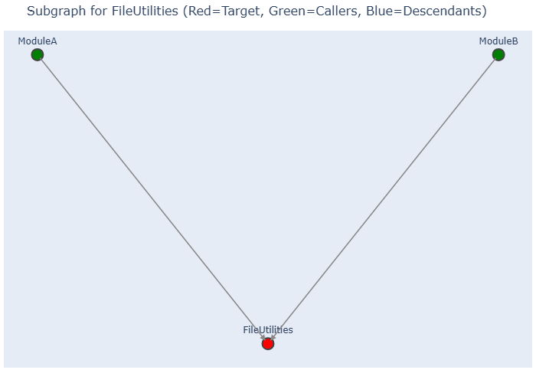
Dependency Visualization Tools
generate_dependency_graph_for_selected_nodes.py
Script to generate a visualization for selected libraries.
Selected libraries are passed using argument --nodes
python generate_dependency_graph_for_selected_nodes.py --nodes ModuleA FileUtilities ModuleB
Generates separate graph for each selected node.

Slide 28
Additional CI Pipeline Checks – Yet to be implemented For effective dependency monitoring and improved code quality
✅ Check if every file is associated with a specific library (.lvlib)
If there are VIs not associated to library, then it can introduce unnecessary dependencies.
✅ Check if Source Code is separated from Compiled Code.
Reduces file changes in Pull requests
✅ Ensuring Build Readiness
Check for missing VIs, Incorrectly claimed libraries, Broken VIs
Check if every library is added to at least one of the build specification.

Slide 29
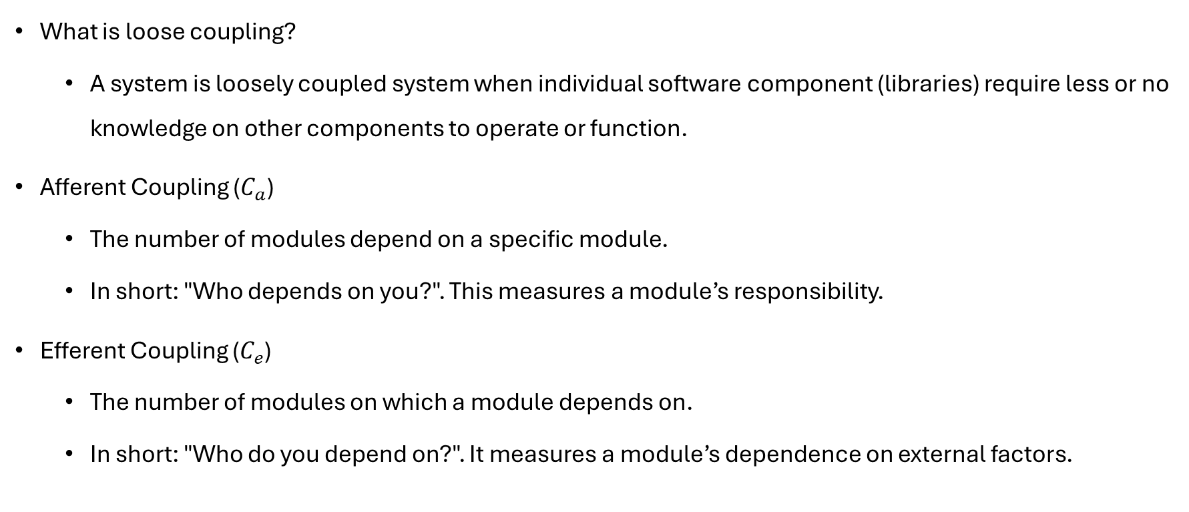
Short Introduction to Coupling Metrics
What is loose coupling?
A system is loosely coupled system when individual software component (libraries) require less or no knowledge on other components to operate or function.
Afferent Coupling ($C_{a}$)
The number of modules depend on a specific module.
In short: "Who depends on you?". This measures a module’s responsibility.
Efferent Coupling ($C_{e}$)
The number of modules on which a module depends on.
In short: "Who do you depend on?". It measures a module’s dependence on external factors.
References:
Robert C. Martin (2002). Agile Software Development: Principles, Patterns, and Practices.
https://en.wikipedia.org/wiki/Software_package_metrics

Slide 30
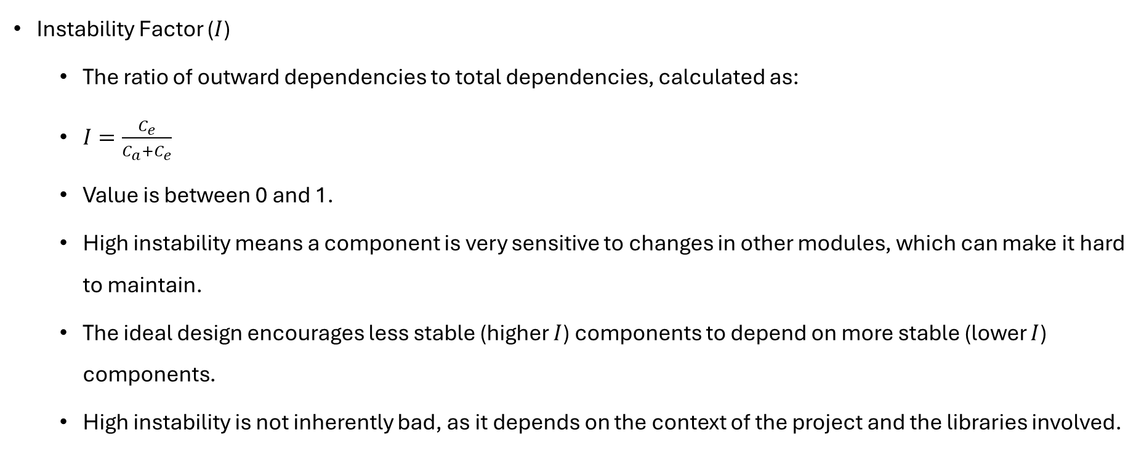
Short Introduction to Coupling Metrics
Instability Factor ($I$)
The ratio of outward dependencies to total dependencies, calculated as:
$I=\frac{C_{e}}{C_{a}+C_{e}}$
Value is between 0 and 1.
High instability means a component is very sensitive to changes in other modules, which can make it hard to maintain.
The ideal design encourages less stable (higher $I$) components to depend on more stable (lower $I$) components.
High instability is not inherently bad, as it depends on the context of the project and the libraries involved.
References:
Robert C. Martin (2002). Agile Software Development: Principles, Patterns, and Practices.
https://en.wikipedia.org/wiki/Software_package_metrics

Slide 31
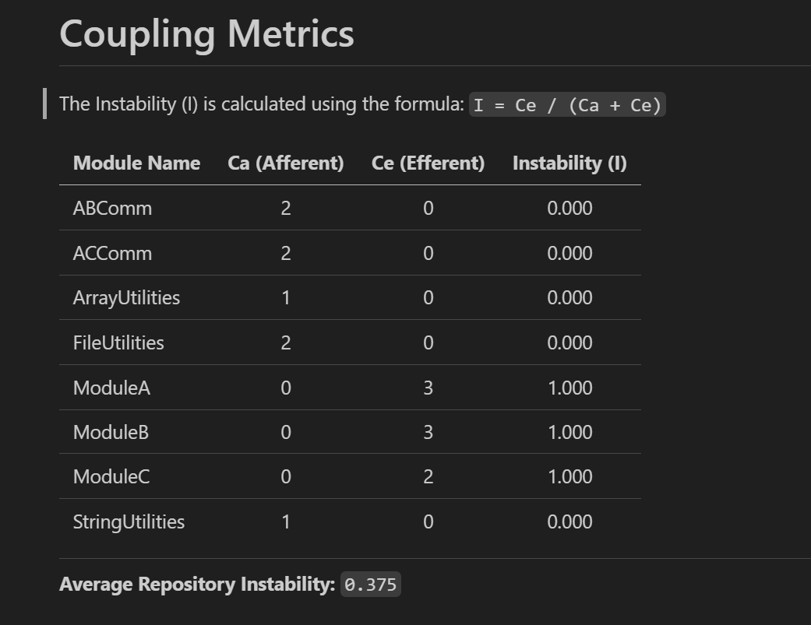

Coupling Metrics Report Generation
calculate_coupling_metrics.py
$I$ values closer to 0 indicates stable libraries.
$I$ values closer to 1 indicates instability.
The top level modules would have $I=$1, since it will not be called by any other modules (Ca=0).
Libraries with low Ce values → Indicates they do not call many other libraries and are mostly independent.
Libraries with high Ca values → Indicates they are actively used in many libraries. Changing it can have impact on other libraries.
Average Instability of all the libraries helps understand overall stability of the system.

Slide 32
Summary: Advantages of Automated Dependency Monitoring
✅ Maintained Architectural Integrity: Dependencies strictly adhere to the defined architecture, preventing circular references and unnecessary coupling.
✅ Enhanced Reusability: Modules remain focused and free from unwanted dependencies, simplifying reuse in future projects.
✅ Improved Maintainability: Clearer, more stable modules are easier to isolate and test, debug, and update independently.
✅ Guided Architectural Changes: In scenarios where a dependency needs to be introduced and design must be changed – Since the CI Pipeline prevents the merge to the main code branch – Developers will consult with Tech Leads/Architects and seek their guidance/approval before the implementation.
✅ Streamlined Development: Since the separation of concerns is verified by CI Pipeline, the multiple developers working on the project will have reduced code conflicts.
✅ Reduced Code Review Time: Automated checks minimize manual dependency reviews.
✅ Faster Loading: Fewer dependencies lead to quicker LabVIEW project loading times.

Slide 33
Thank You

